Slide 1

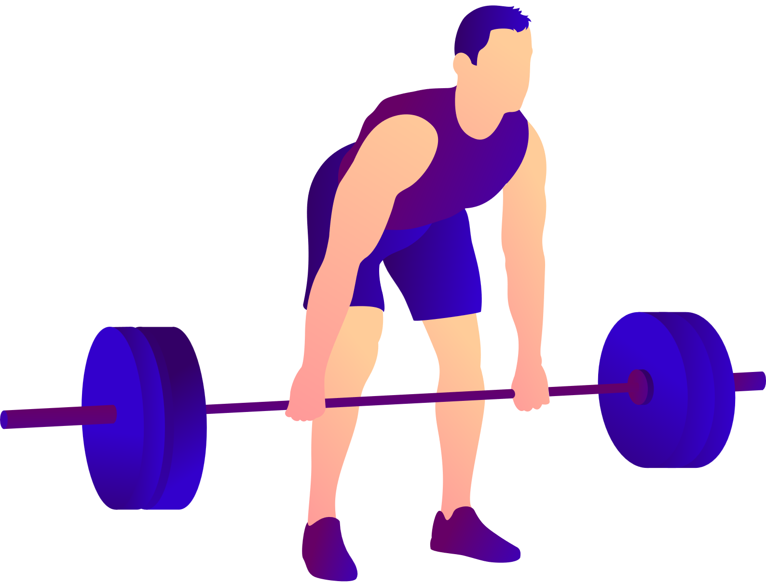
FITNESS
TRACKER
TEAM MEMBERS:
POLIREDDY UDITHA
SIDDIREDDY KOMALI
RAHUL K
SYED ROSHAN
VIGNESH KUMAR

Slide 2
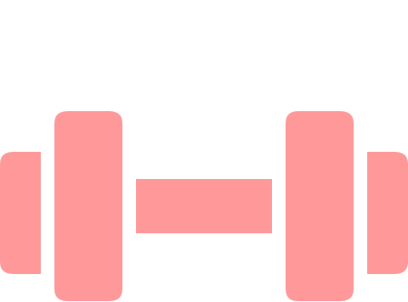

Fit-bliss :- Your Personal Fitness Companion
INTRODUCING FITBLISS
Fit-bliss is a comprehensive fitness tracking application designed to help users monitor and manage their physical activity and calorie expenditure. This standalone Java and MySQL-based application provides personalized fitness recommendations, exercise logging capabilities, and visual feedback to support your health journey.
With Fit-bliss, you can create a personalized profile, track your daily exercises, visualize your progress, and review your exercise history—all in one convenient application.

Slide 3
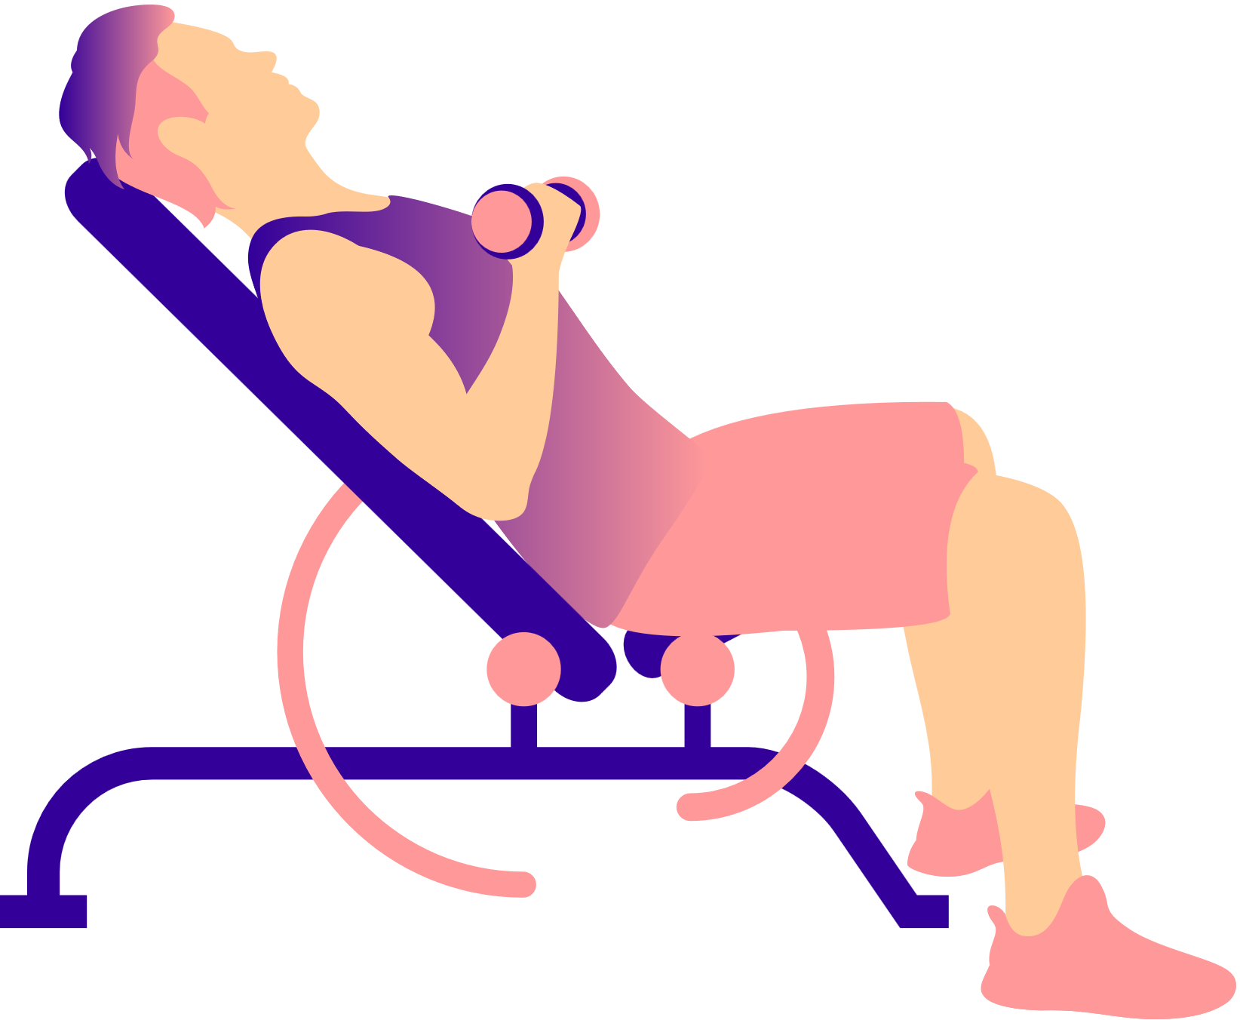
FIT-BLISS
Key Features of Fit-bliss
User Account Creation -
Input personal details like height, weight, birth year, and gender to create a personalized profile that serves as the foundation for your fitness journey.
Calorie Recommendations -
Receive personalized daily calorie burn goals calculated based on your unique profile data through a specialized logic algorithm.
Exercise Logging -
Record your daily exercises including type, duration, and intensity, with automatic calculation of calories burned for each activity.
Visual Feedback & History -
View your progress through intuitive pie charts and access your complete exercise history to track improvements over time.

Slide 4








System Architecture
Frontend (GUI)
Java Swing-based interface
Backend (Logic)
Java processing & calculations
Database (MySQL)
Structured data storage
Fit-bliss features a three-tier architecture that ensures smooth operation and data management. The frontend provides an intuitive Java Swing interface for user interaction through forms and charts. The backend handles all logic including user input processing, calorie calculations, and database operations.
The MySQL database forms the foundation, storing all user profiles, exercise logs, and history data in structured tables, allowing for efficient data retrieval and management.

Slide 5




Setting Up Fit-bliss
Download the Application
Obtain the Fitbliss.jar executable file from the repository
Set Up the Database
•Download Fit-bliss-Database.sql file
• Install XAMPP or WAMP server stack
•Start Apache and MySQL services
•Create a database named "fitbliss"
• Import the SQL file
Run the Application
Open the Fitbliss.jar file to start using the application

Slide 6
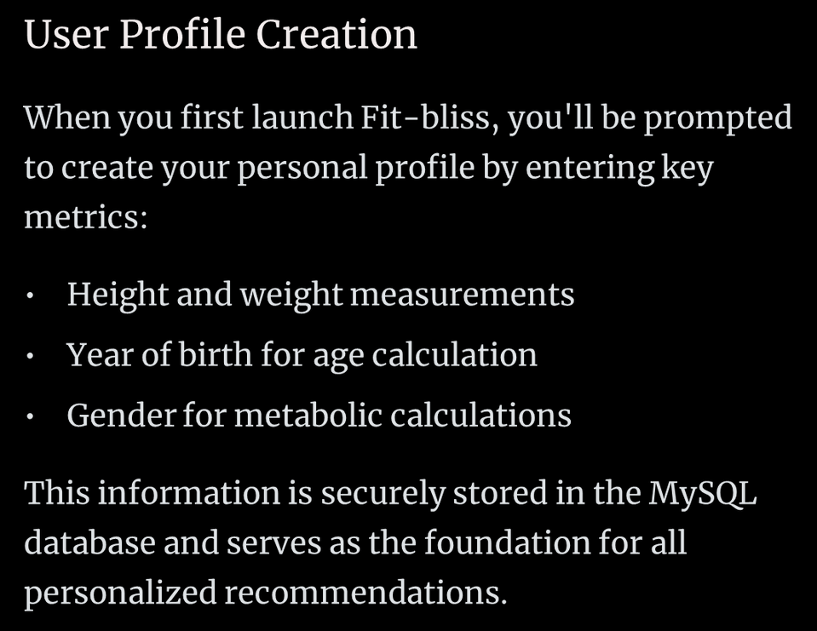
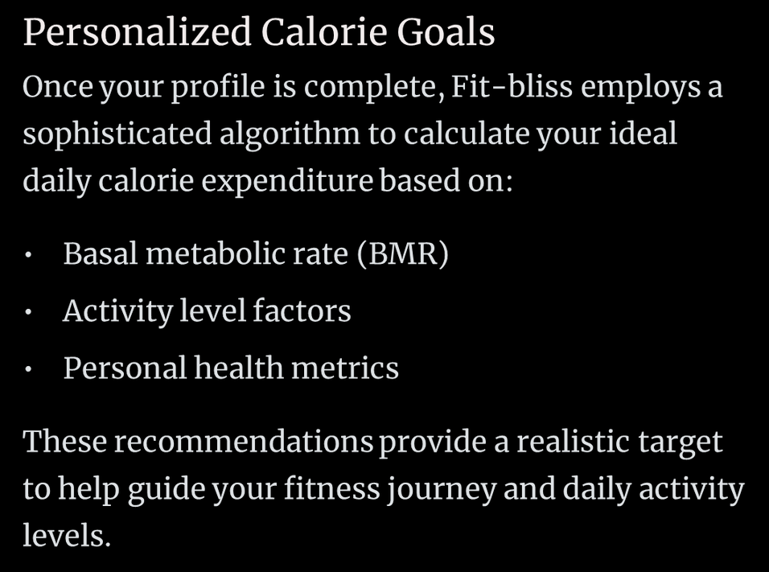
User Account & Calorie Recommendations

Slide 7
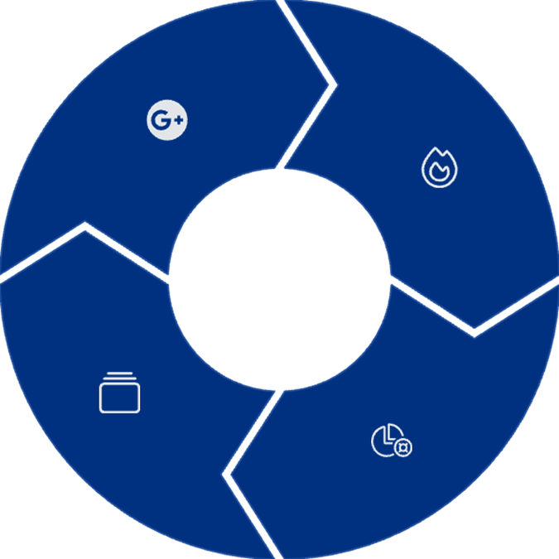
Exercise Logging & Visualization
Log Exercise
Calculate Calories
Record activity type, duration, and intensity
System determines calories burned
Track History
View Progress
See goal completion in pie chart
Fit-bliss makes exercise tracking intuitive and rewarding. After logging your workouts with specific details, the application automatically calculates calories burned based on exercise type and intensity. The visual pie chart representation helps you instantly understand your progress toward daily goals, while the history feature allows you to review past performance and identify trends in your fitness journey.

Slide 8
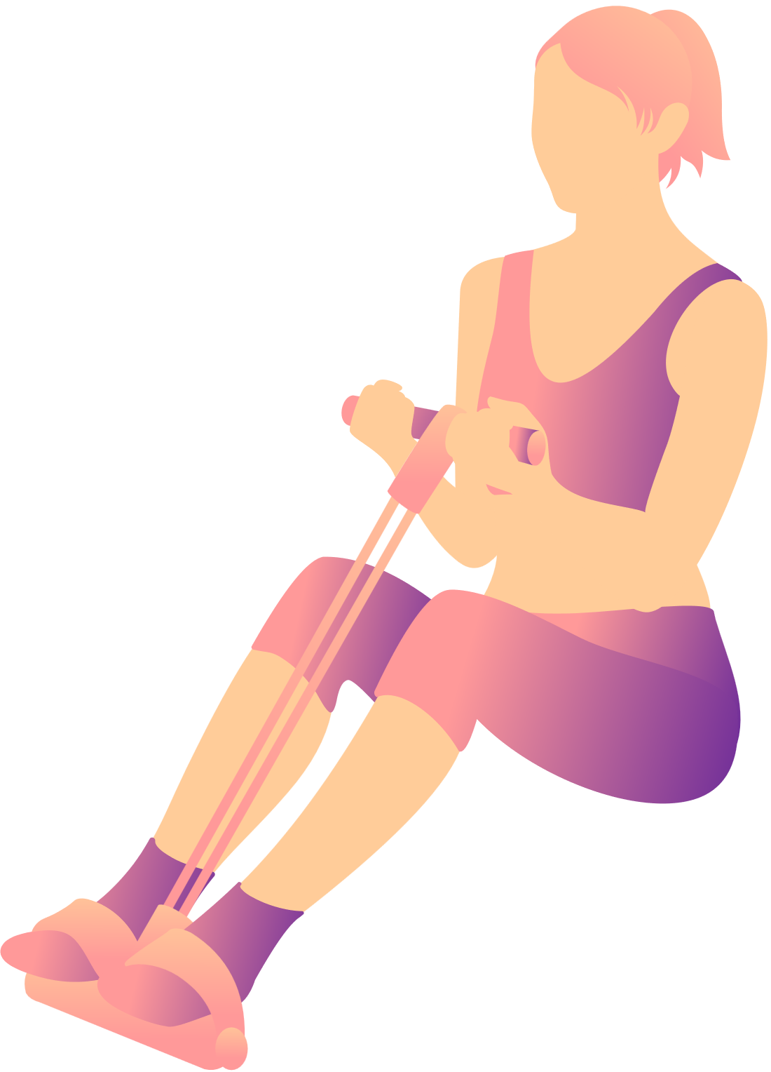

Database Schema Overview
Table Name
Purpose
Key Fields
Stores user profile information
user_id, name, gender, height, weight, birth_year
user
exercise_log
Records workout entries
log_id, user_id, exercise_type_id, duration, intensity, date
exercise_type
Defines activity categories
type_id, name, calorie_metrics
The Fit-bliss database is structured around three primary tables that work together to store and manage all user data. The user table maintains personal profiles, while the exercise_log table tracks all workout activities linked to specific users. The exercise_type table contains standardized information about different physical activities and their associated calorie burn metrics.
This relational structure ensures data integrity while allowing for efficient queries and reports on user fitness activities and progress over time.

Slide 9
Benefits
Personalized Calorie Tracking
Comprehensive Exercise Logging
Visual Activity Representation
Secure Data Management
Historical Data Access

Slide 10
CONCLUSION
Fitbliss is a helpful fitness app that lets users track their daily exercises and calories in a simple way. It gives personal fitness goals, shows progress with charts, and keeps a record of all past workouts. With easy-to-use features and secure data storage, it’s a great tool for anyone who wants to stay healthy and reach their fitness goals.

Slide 11
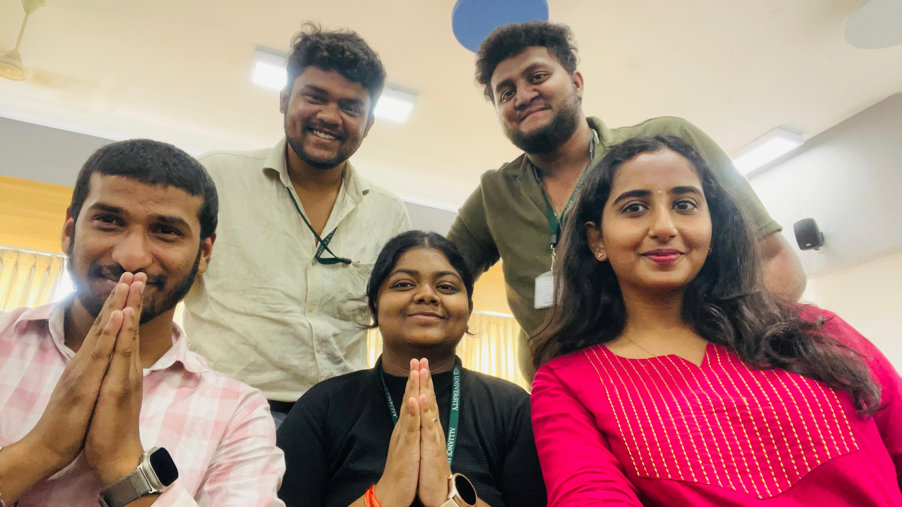

THANK YOU
THANK YOU

